Slide 1
Recent Experimental Characterization of Li-Ion Electrode
Data from:
  M. Ebner, F. Geldmacher, F. Marone, M. Stampanoni, and V. Wood, "X-Ray Tomography of Porous, Transition Metal Oxide Based Lithium Ion Battery Electrodes," Advanced Energy Materials, vol. 3, pp. 845-850, 2013.
Li Ni_{1/3}Mn_{1/3}Co_{1/3}O₂ (NMC)-based cathodes
Varying weight percent of carbon black and binder (2–5 wt%)
Applied pressures (0-2000 bar)

Slide 2
Mesh Generation for Cathode X-Ray Tomography
X-Ray tomography of large volumes 700x700x70 microns
Data can be used for particle size distribution, location, shape, etc.
The data consists of sets of raw, processed and segmented images that give voxelized data.
Data was used to develop different models and representations of battery microstructure.
Results published in:
  A. J. Stershic, S. Simunovic, and J. Nanda, "Modeling the evolution of lithium-ion particle contact distributions using a fabric tensor approach," Journal of Power Sources, vol. 297, pp. 540-550, 2015.

Slide 3
Basic Tomography Processing
Apply contrast to separate particles from the background
Use watershed algorithm for separating particles
Assign color ids to different particles

Slide 4


Slide 6
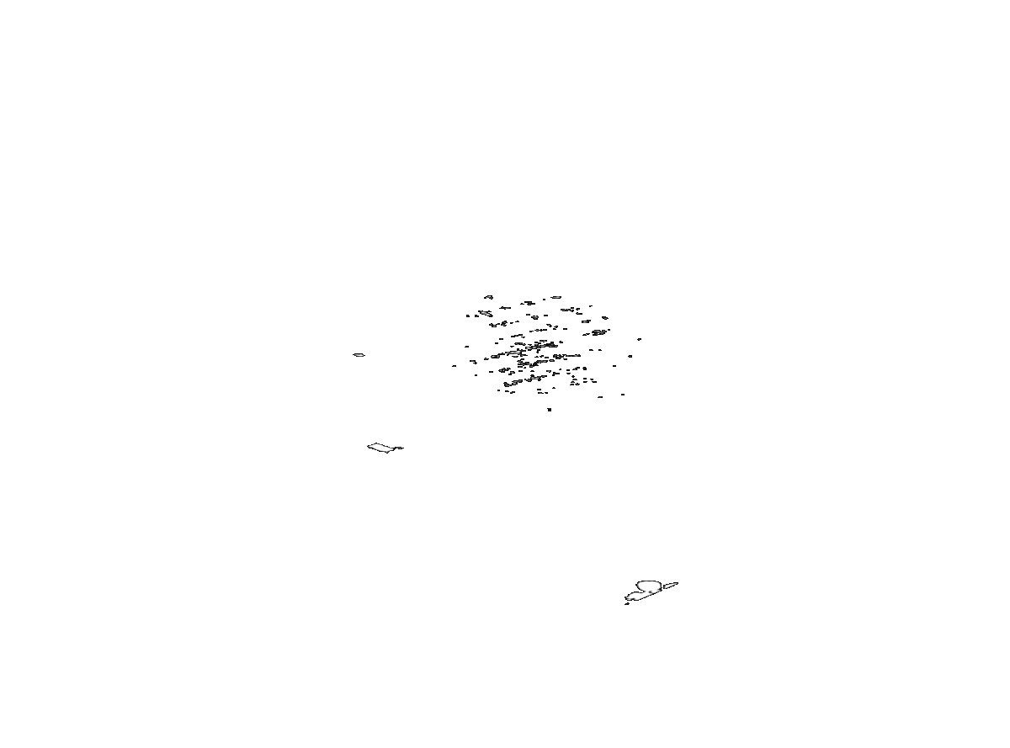
Full Segmented Scan
Sequence of tomography sections
Ebner, et al, 2013.

Slide 7
Data Available in ORNL Dropbox
http://energy.ornl.gov/BatML/downloads/batterymicro

Slide 8
Data Processing for FEM Mesh Development
Original data is in voxel form
Pure voxel form has too high a resolution, stepwise boundaries, and inaccurate particle surface sizes
The particles and the assembly need to be processed to generate feasible computational meshes

Slide 9
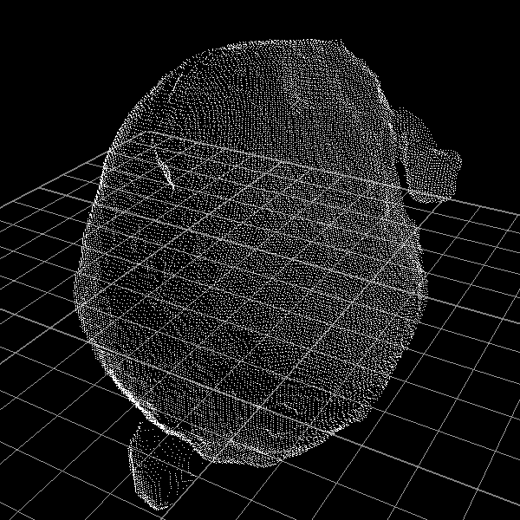
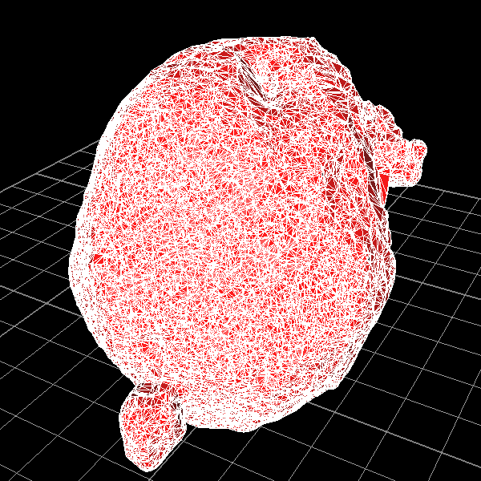
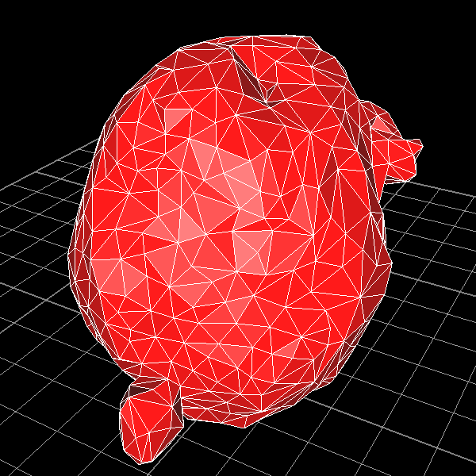
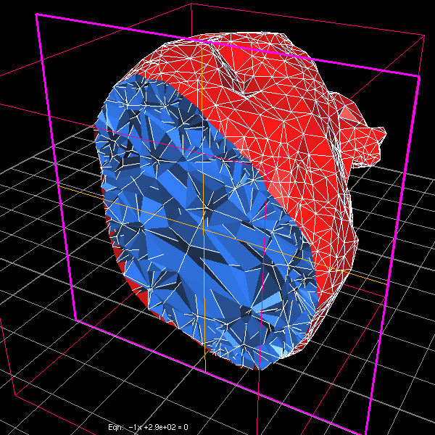
Processing steps
http://energy.ornl.gov/BatML/downloads/batterymicro/workflow
Select the surface of a particle
Shrink-wrap it
Simplify the surface to needed resolution
Mesh the volume

Slide 10
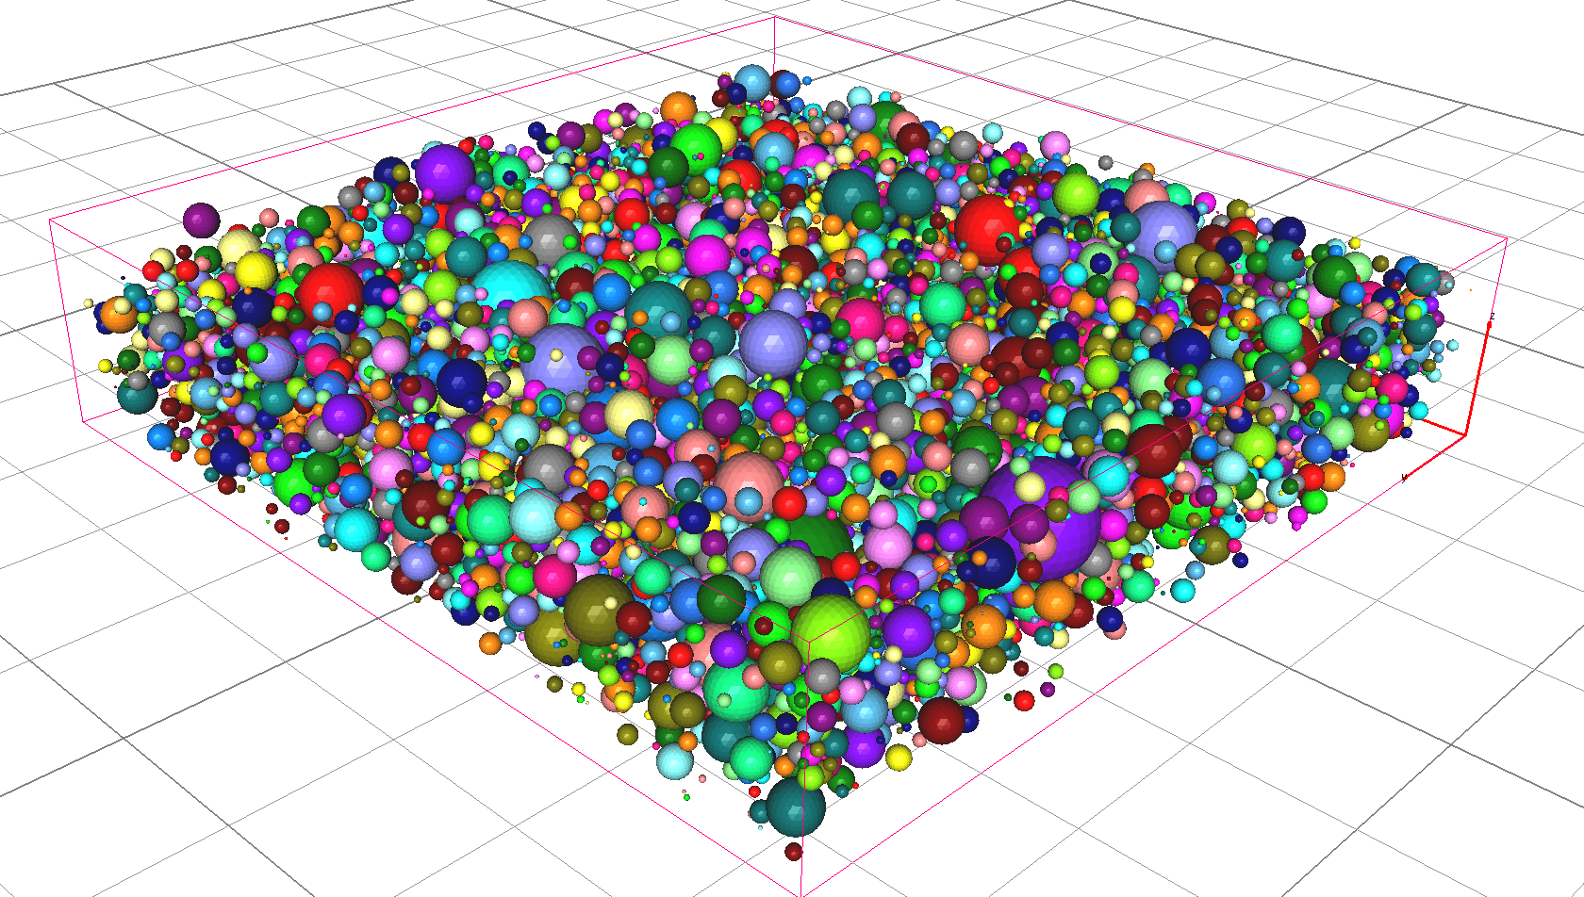
Spherical vs Polygonal Particle Mesh
Spherical

Slide 11
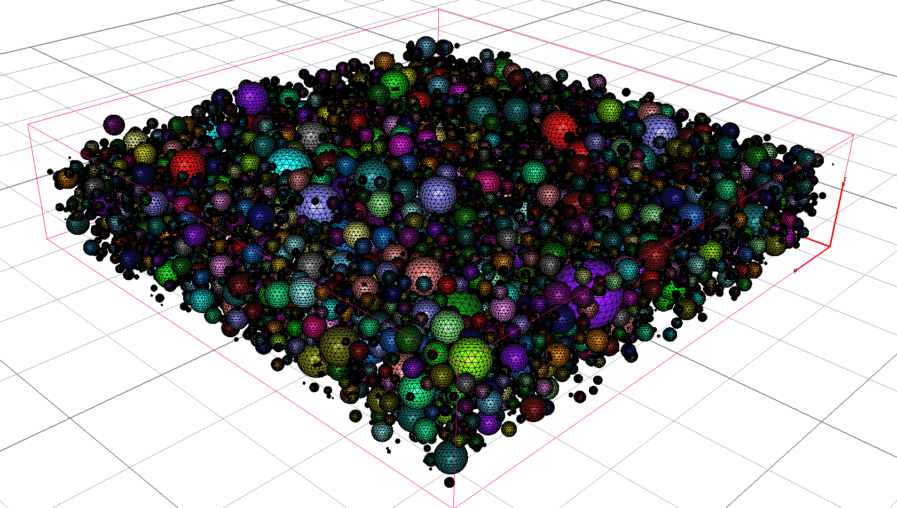
Spherical vs Polygonal Particle Mesh
Spherical

Slide 12
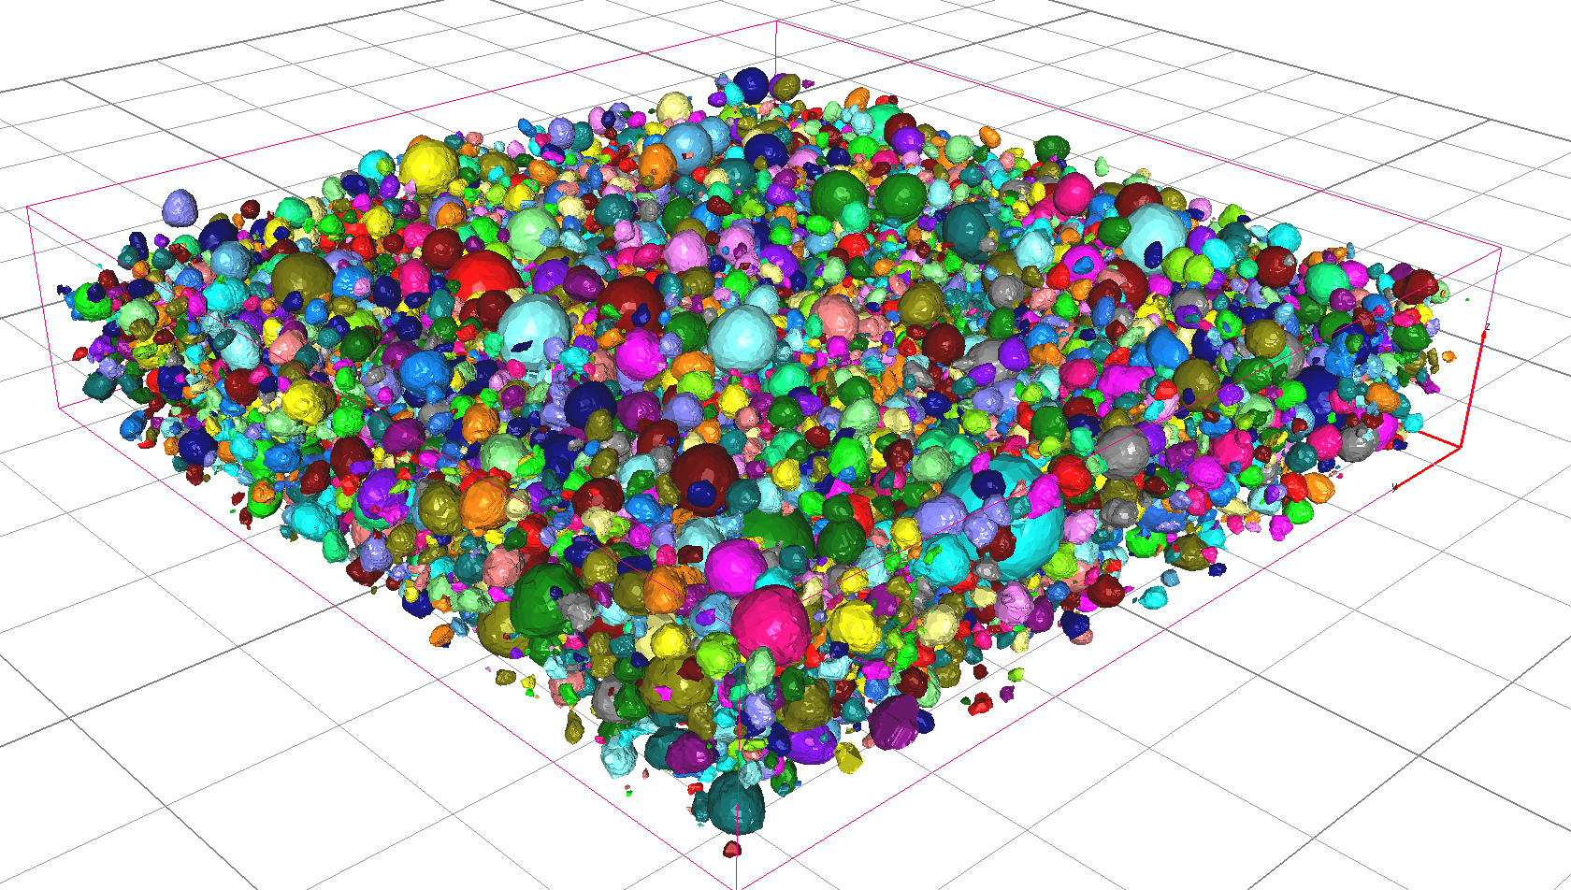
Spherical vs Polygonal Particle Mesh
Polygonal

Slide 13
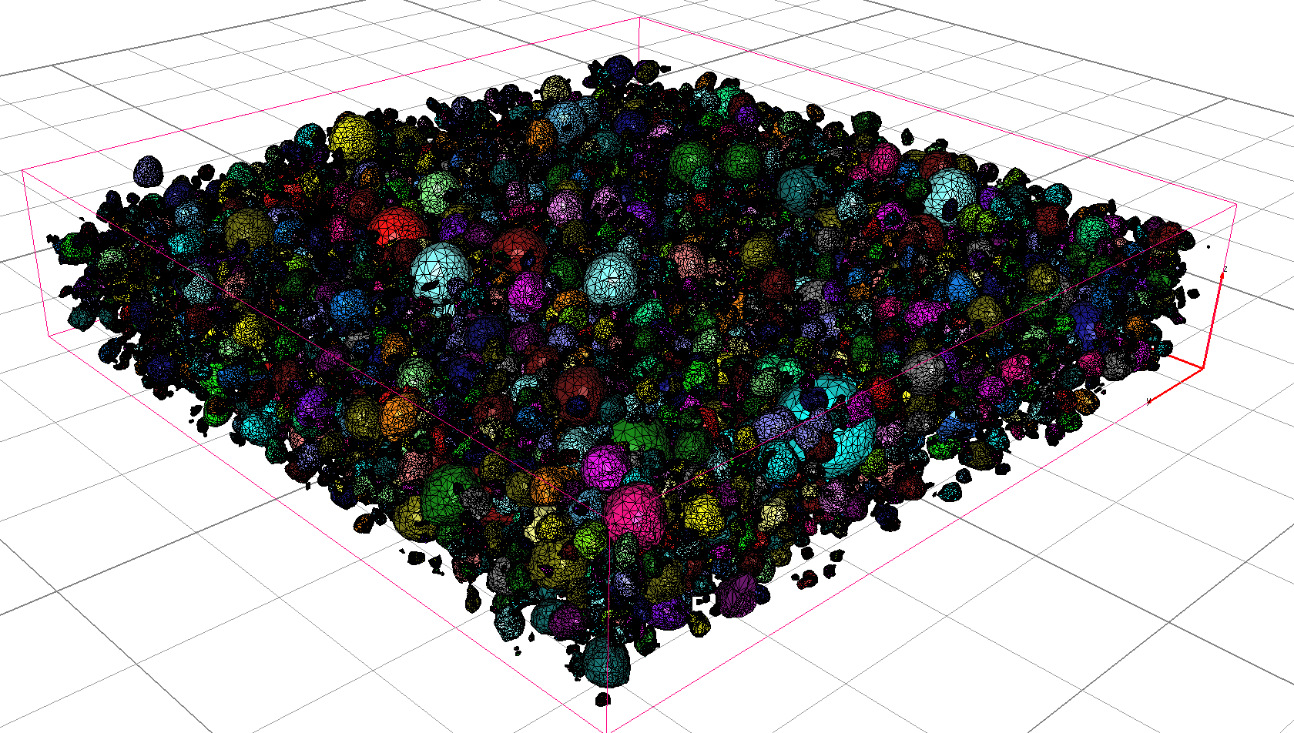
Spherical vs Polygonal Particle Mesh
Polygonal

Slide 14
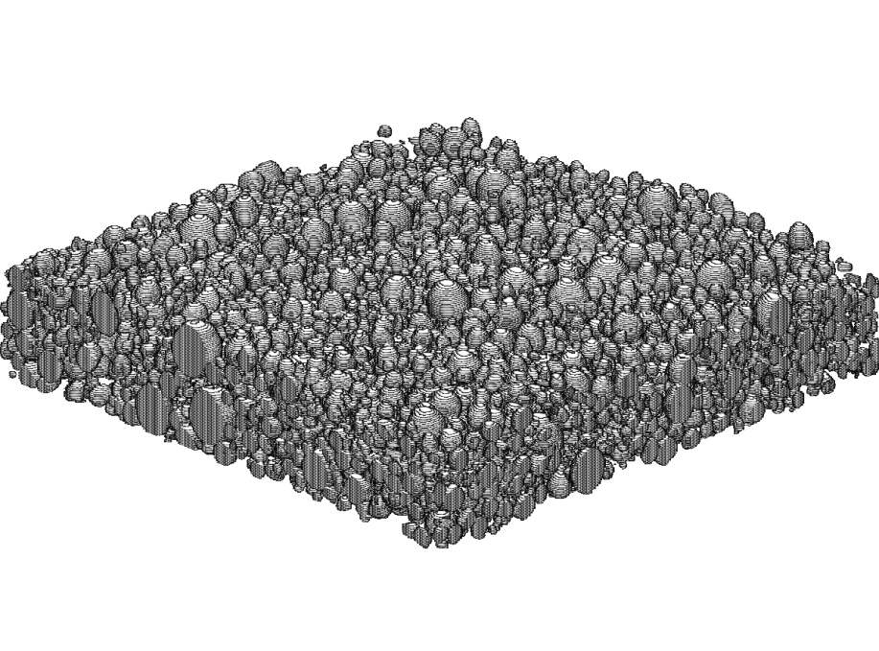
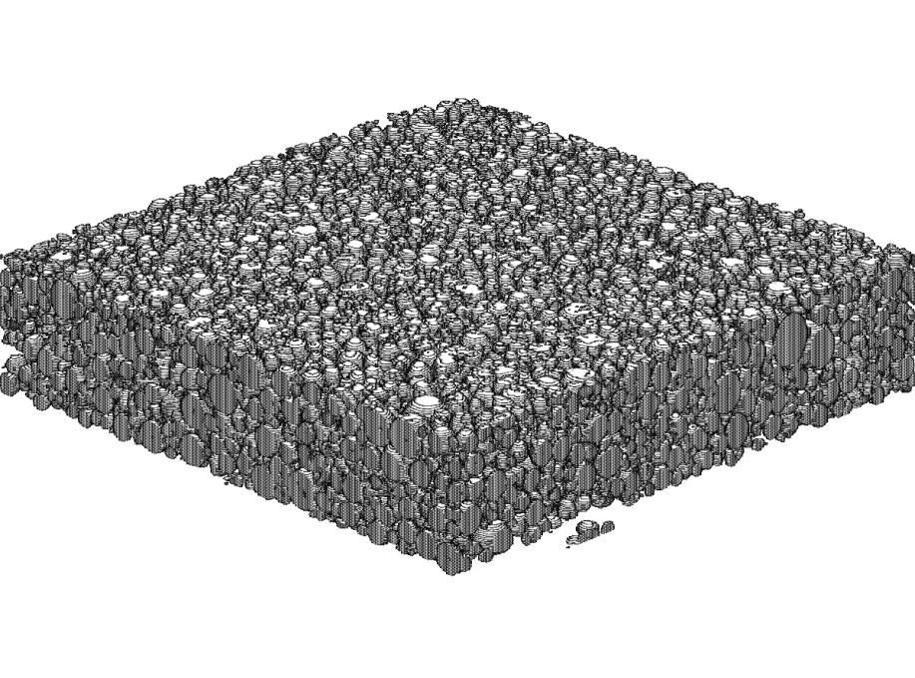
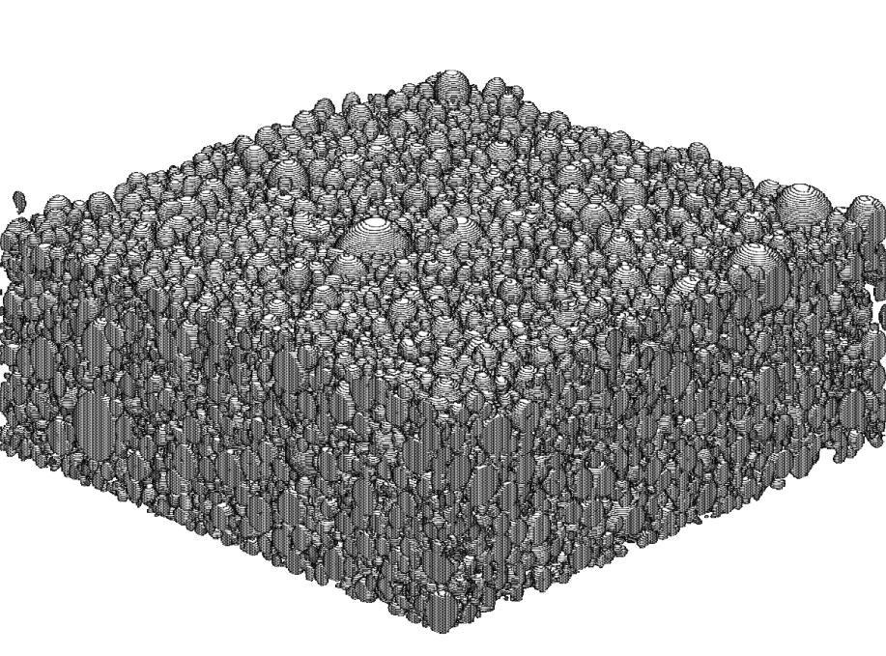
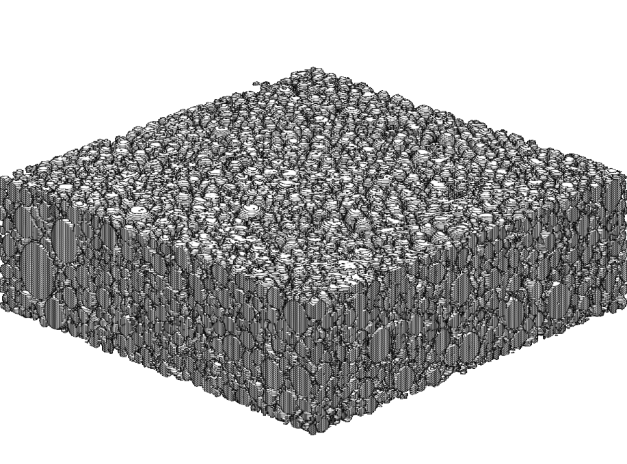
Effect of Calendaring Pressure
Particle scans show more smaller particles at after application of high pressures
0 bar
2000 bar
Ebner, et al, 2013.

Slide 15
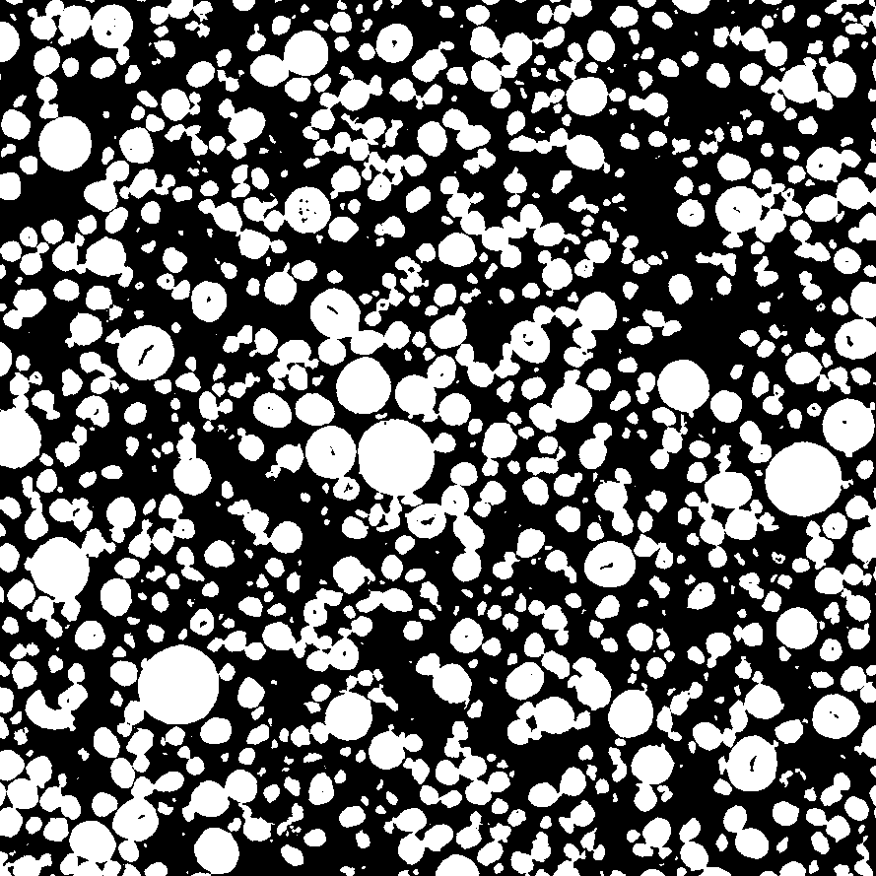
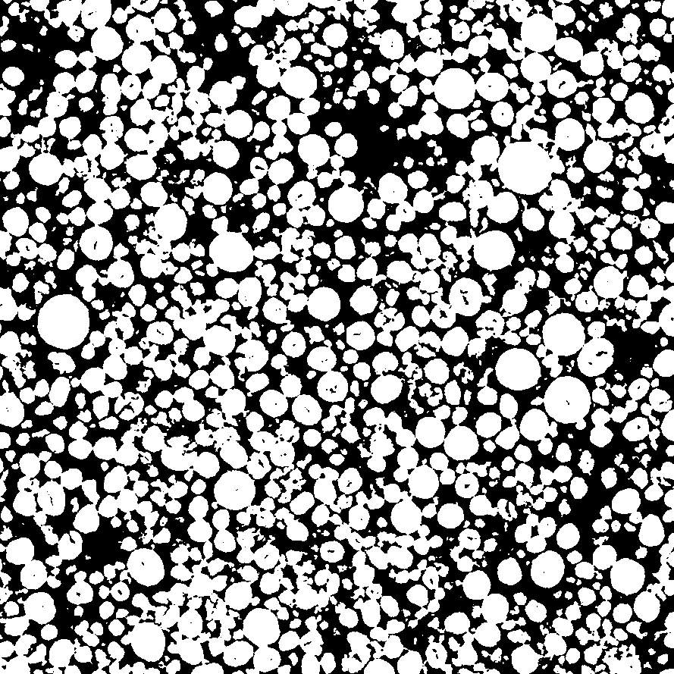
Effects of Pressure
0 bar
2000 bar
Ebner, et al, 2013.

Slide 16
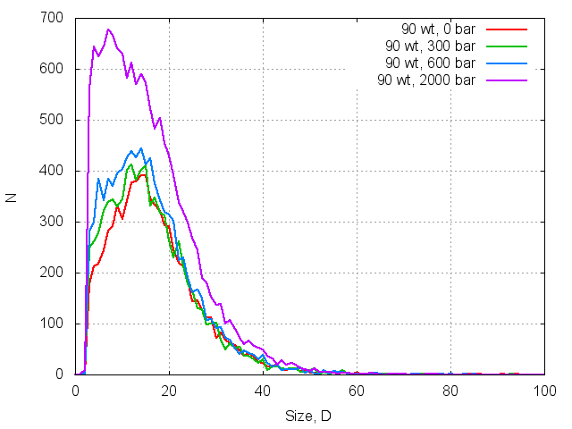
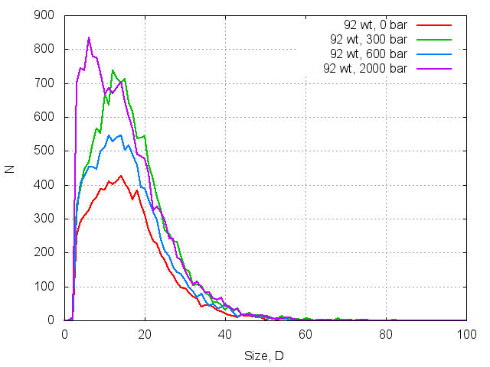
Particle Distributions
Particle size distributions show evidence of fracture
Distribution shifts to the smaller sizes with increasing pressure
Ebner, et al, 2013.

Slide 17
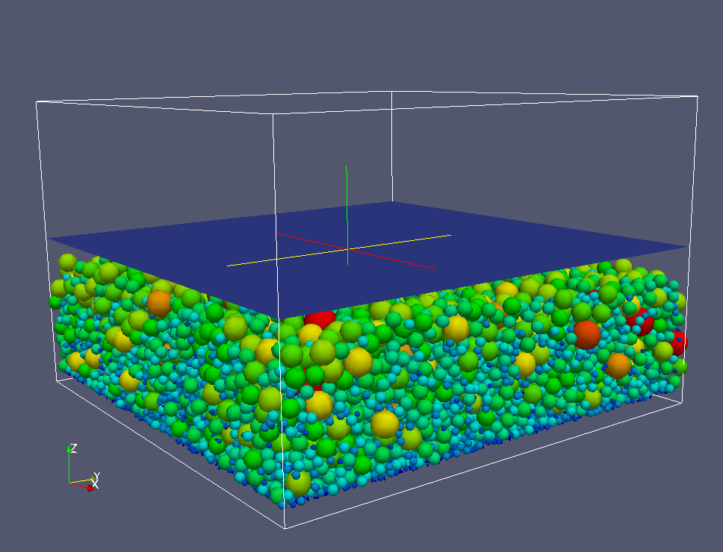
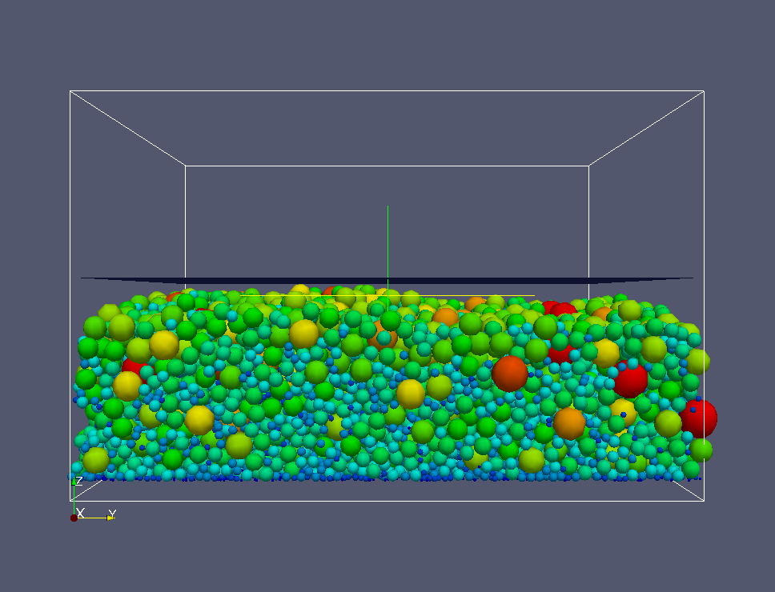
Model for Particle Compression
Particles modeled as elastic spheres
Andrew Stershic, Duke U.

Slide 18
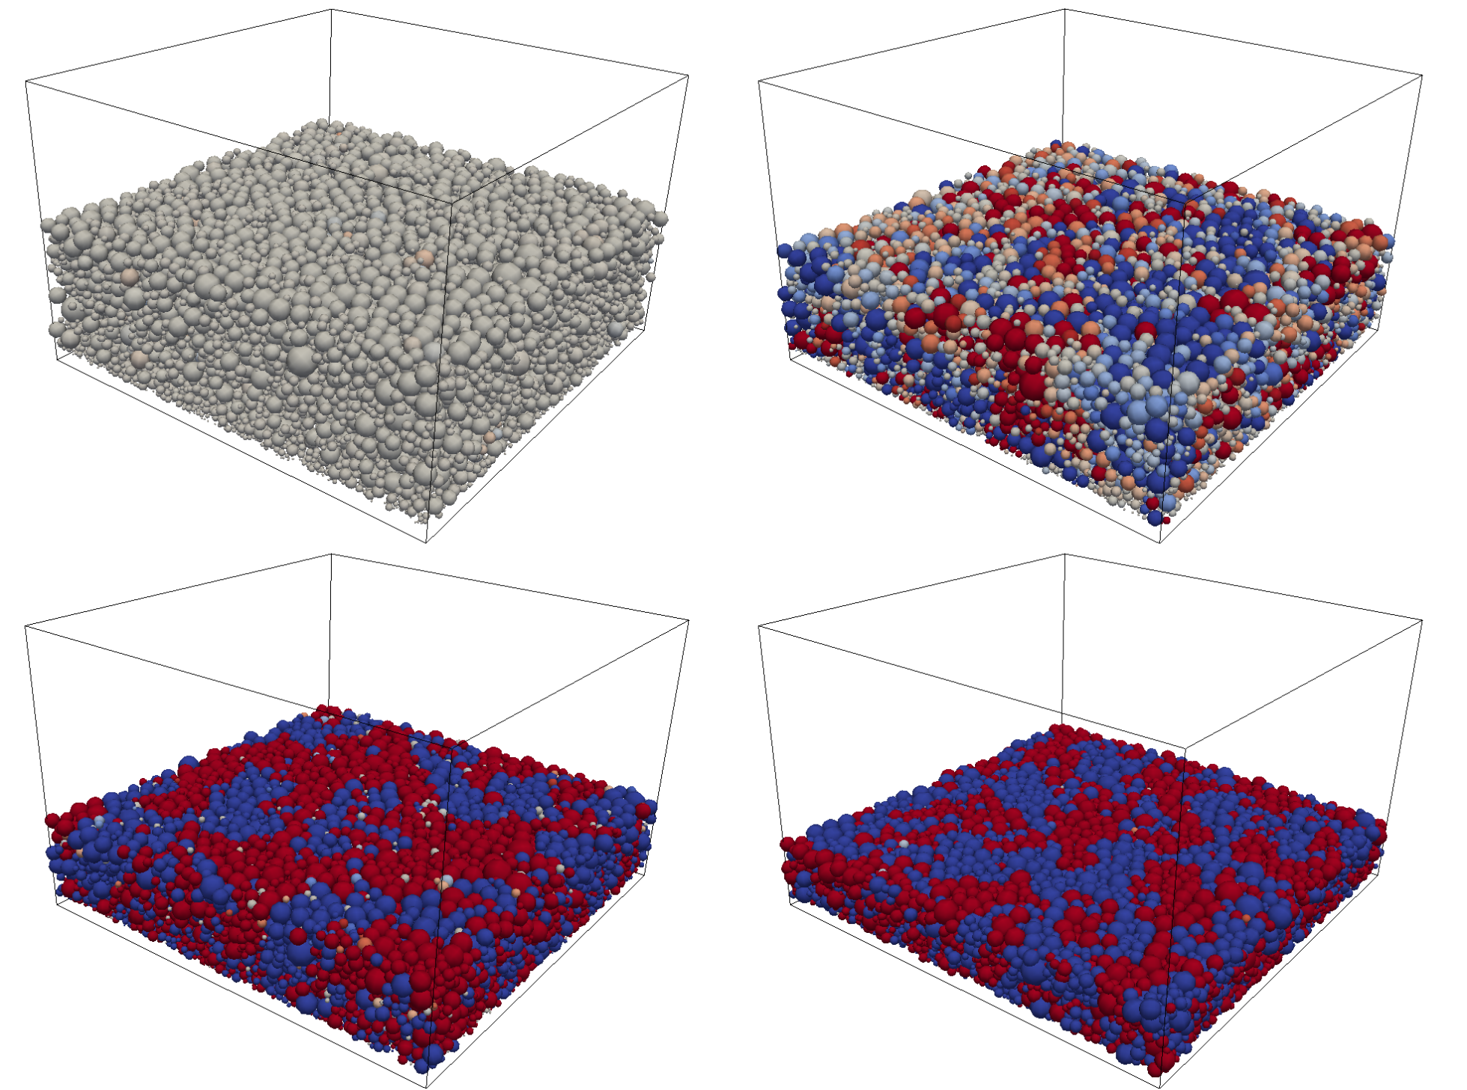
Compressive Force in Particles

Slide 19
Summary
Developed process and programs for processing tomography data to generate FEM models for particle assemblies.
Model resolution can be prescribed.
Example mesh in INRIA mesh format at:
  http://energy.ornl.gov/BatML/downloads/batterymicro/mesh/
Other formats can be made available as needed.
We can modify the process further as required by the team.

